Slide 1

Project Title- Seasonal Agriculture Performance Analysis
Student Name- Nishant Kumar
College Name- Sitamarhi Institute Of Technology
AICTE STU ID : STU6a69e1d2dc58f1785323986

Slide 2

PROBLEM STATEMENT
Agricultural activities are influenced by seasonal variations in environmental conditions, farming practices, resource availability and market conditions. As a result, agricultural performance may differ from one season to another.
However, raw agricultural data does not clearly explain how agricultural performance changes across seasons or what patterns can be observed in different seasonal conditions.
The problem is to analyze the given agricultural dataset and investigate seasonal differences in agricultural performance by identifying meaningful patterns, trends, relationships and variations within the available data.

Slide 3
Project Description Seasonal Agriculture Performance Analysis is a Data Analytics project based on agricultural records from different seasons, geographical areas and farming conditions. The dataset includes crop production, environmental conditions, farming practices, resource usage and economic performance. The project analyzes and compares agricultural performance across Kharif, Rabi and Zaid seasons to identify meaningful patterns, trends and relationships.

Slide 4

WHO ARE THE END USERS?
Farmers
Agriculture Officers
Use insights to improve crop planning and farming practices.
Monitor seasonal agricultural performance and trends.
Researchers
Government Policy Makers
Study relationships between seasons and crop productivity.
Use data insights for agricultural planning and policies.

Slide 5

Technology Used
Python — Data Analysis and Statistical Processing
Pandas — Data Cleaning, Transformation and Aggregation
NumPy — Numerical Operations
Matplotlib / Seaborn — Data Visualization
Jupyter Notebook / Google Colab — Reproducible Documentation
CSV — Agricultural Source Dataset

Slide 6
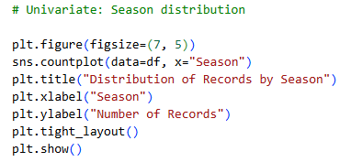
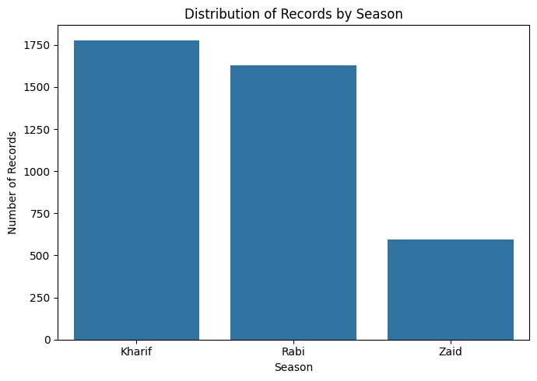
RESULTS
This bar chart shows the distribution of agricultural records across three seasons.
Kharif has the highest number of records, followed by Rabi, while Zaid has the lowest representation.
The dataset contains approximately 1,780 Kharif records, 1,630 Rabi records, and 600 Zaid records.
Overall, Kharif and Rabi seasons are more strongly represented in the dataset than Zaid.

Slide 7
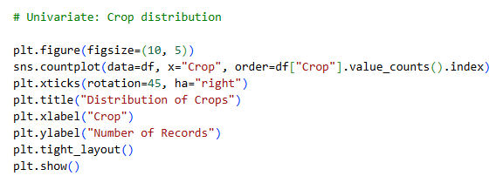
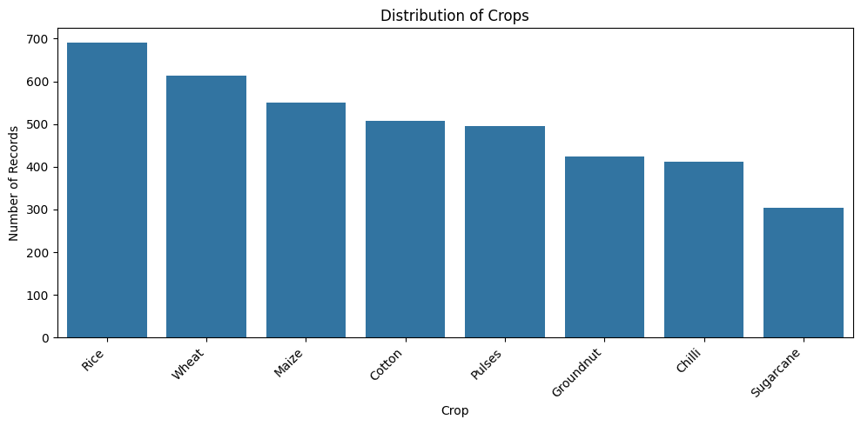
RESULTS
This bar chart represents the number of records for different crops. Rice has the highest representation with approximately 690 records, followed by Wheat (610) and Maize (550). Cotton and Pulses have around 510 and 495 records, respectively. Groundnut and Chilli have slightly lower counts, while Sugarcane has the fewest records at around 300. Overall, the dataset is fairly diverse, but Rice and Wheat are the most frequently represented crops.

Slide 8
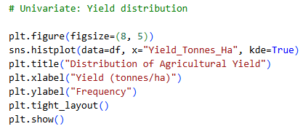
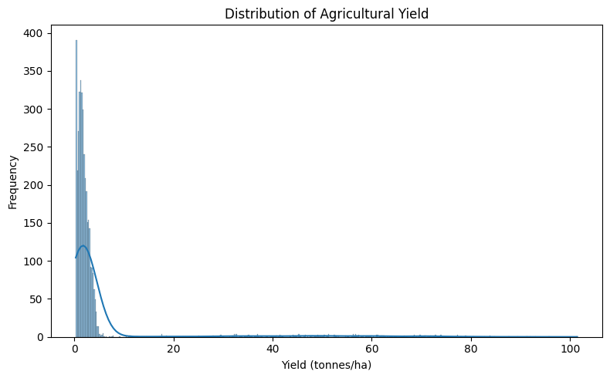
RESULTS
The histogram shows the distribution of agricultural yield in tonnes per hectare. Most observations are concentrated at relatively low yield values, mainly between 0 and 8 tonnes/ha. The distribution is strongly right-skewed, meaning that a small number of observations have exceptionally high yields. There are several extreme values extending beyond 20 tonnes/ha and even toward 100 tonnes/ha. These extreme observations may represent unusual production conditions, different crop types, or potential outliers in the dataset.

Slide 9
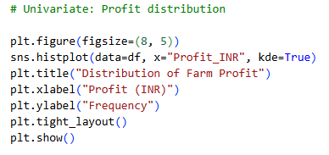
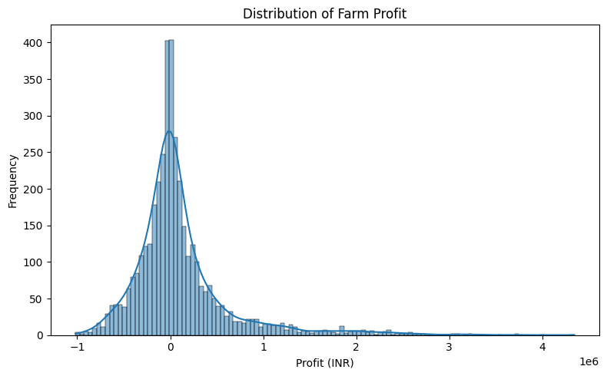
RESULTS
The histogram shows the distribution of farm profit in INR. Most profit values are concentrated around ₹0, while the distribution also contains both negative and positive values. Negative values represent loss-making observations, extending to around -₹1 million. Positive profits extend to more than ₹4 million, showing a long right tail. The large spread indicates substantial variation in farm profitability. However, the extreme values should not be assumed to represent typical farm performance and may include unusual observations or outliers.

Slide 10
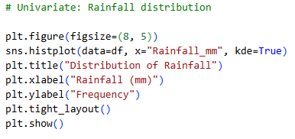
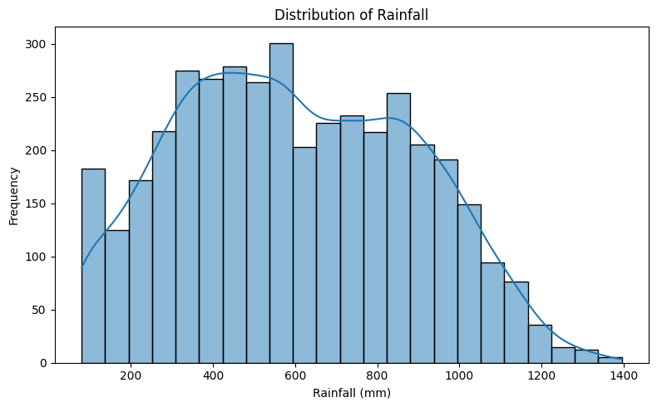
RESULTS
The histogram shows the distribution of rainfall in millimetres (mm). Most observations fall between approximately 300 and 1,000 mm, with the highest frequency around 500–600 mm. Rainfall values extend from about 100 mm to 1,400 mm, indicating considerable variation across the dataset. The distribution gradually decreases at higher rainfall levels, with relatively few observations above 1,200 mm. Overall, the dataset contains a wide range of rainfall conditions across different observations.

Slide 11
Future scope
Predict future crop yields using AI and machine learning.
Provide crop recommendations based on season and soil conditions.
Integrate real-time weather and rainfall data.
Develop a mobile app for farmers.
Improve productivity through data-driven farming decisions.

Slide 12
GitHub Link
https://github.com/nishantkr288/Seasonal-Agriculture-Performance-Analysis

Slide 13

VOIS Course completion certificate - Course name- Data Visualization

Slide 14
Thank you
Seasonal Agriculture Performance Analysis
.
.

